Slide 1
American School Shootings: Understanding the problem & data
Nirajkumar Singh, Shanmukha Damineni, Zahid Rahman

Slide 2
Outline
1
2
3
4
5
Problem & Significance
Prior
Research
Data
Preprocessing
&
EDA
Modeling,
Results, Recommendation
6
Conclusion & References

Slide 3
1
Problem & Significance
Nirajkumar

Slide 4
Problem
School shootings, defined as "any time a gun is brandished on school property," have become a uniquely pervasive issue in the United States. While once rare, these tragic events now occur frequently, shattering communities and elevating concerns about student safety.

Slide 5
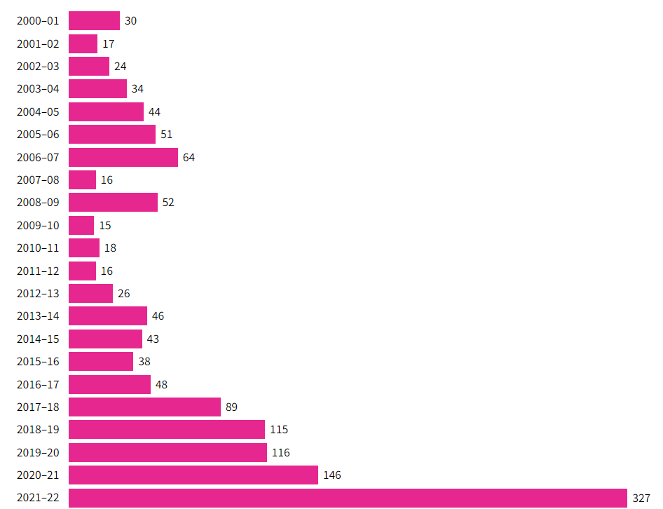
Frequency of school shootings at public & private elementary & secondary schools

Slide 6
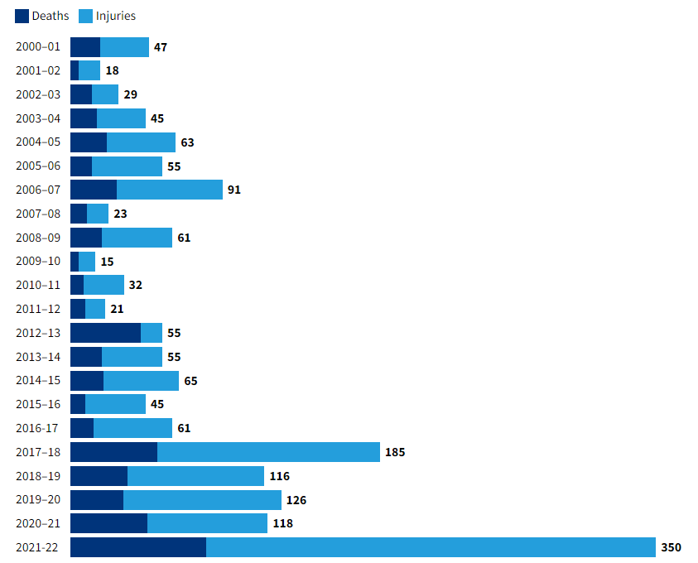
Number of deaths or injuries from school shootings

Slide 7
Effects of School Shooting: Mental Health & Education
100,000+ US students attended a school at which a shooting took place in 2018 and 2019.
Effects:
Increase in anti-depressant use
Decline in academic performance
Lower test scores
Higher absenteeism
Repeat grades or drop out
Less likely to graduate from high school
Reduced employment opportunities
Lower earning in adulthood

Slide 8
Prior Research
2
Shanmukha

Slide 9
Current situation & problems statement
Source | Problem | Methods | Key Findings | Recommendations / Conclusion
Getting Ahead of School Shootings: A Call for Action, Advocacy, and Research. Lauren W. Collins, Timothy J. Landrum, Chris A. Sweigart | The authors argue that school shootings come from larger societal problems, like weak firearm laws, lack of mental health support, and poor implementation of school safety measures. | Literature Review The paper introduces a framework based on three pillars: Action, Advocacy, and Research | School shootings are widespread and growing Most school shooters get their weapons from family members, revealing gaps in gun safety at home Zero-tolerance policies, leads to harsh discipline for marginalized students and often escalate violence rather than prevent it Active shooter drills have a negative impact Profiling shooters doesn’t work, as there is no consistent profile | The paper argues for balancing immediate preventative actions with long-term, research-driven approaches. It calls for stricter gun control, better mental health support, and smarter policies that avoid making the problem worse, such as zero-tolerance discipline
American Uniqueness Revisited: A Comparative Examination of Two School Shootings Using the Path to Intended Violence. Jaclyn Schildkraut , Nadine Connell , Nina Barbieri, Rafael de Azeredo | Are there any common patterns in the path to violence across different cultural contexts and identify ways to prevent future tragedies? | Comparative case study between school shootings in Florida (2018) and Rio de Janeiro (2011) based on the Path to Intended Violence model Analyze the behavior of the perpetrators | U.S. experiences six times more mass shootings relative to its population, largely due to easier access to firearms Shooters had similar patterns: mental distress and isolation. prepared for their attacks, stockpiling Mental health support was lacking, and warning signs were ignored Gun laws in Brazil are stricter than in the U.S. However, illegal access to firearms in Brazil remains a problem | The comparison of the Parkland and Realengo shootings shows that school shootings follow similar patterns, regardless of cultural differences. The study emphasizes early intervention, better mental health support, and stronger gun regulations as essential to preventing future tragedies.

Slide 10
Current situation & problems statement
Source | Problem | Methods | Key Findings | Recommendations / Conclusions
State firearm laws, gun ownership, and K-12 school shootings: Implications for school safety. By, Paul M Reeping, Louis J Klarevas, Sonali Ranjan, Ali R Rahbar | Do state firearm laws and gun ownership rates influence the occurrence of K-12 shootings in the U.S? | Regression Analysis (GEE, Quasi Poisson, AR1) on dataset collated from Washington post data on k12 shootings and Active school shooting data set. Two separate models for gun ownership and permissiveness (as they were highly correlated) | For every 10-unit increase in gun law permissiveness, school shootings increased by 10.5% For every 10-unit rise in gun ownership, the rate of school shootings increased by 27%, and active school shootings increased by a significant 50.8% School shootings have been on the rise since 2015, with both overall shootings and active shootings increasing significantly Public schools were the primary locations, with most perpetrators being male students under the age of 18 | More permissive firearm laws and higher gun ownership rates are associated with increased rates of school shootings and active school shootings.
An Evaluation of Completed and Averted School Shootings. By, Ashley T Winch, Kristi Alexander, Clint Bowers, Frank Straub | What factors differentiate completed school shootings from averted school shootings? | Logistic Regression to evaluate the ability of age, accomplices, leakage behavior, and motive to predict whether a shooting would be averted or completed T-tests to compare age between groups, and chi square tests for categories | Age alone cannot reliably predict whether a school shooting will be completed Averted shootings were 80% more likely to involve co-conspirators Cases where suspects disclosed their plans to others were far more likely to be averted Suicidal intent is a strong indicator that a shooting will be completed | Most significant predictors of whether a shooting is averted or completed are the involvement of accomplices, leakage warning behaviors, and motives. Research should focus on improving detection methods and intervention strategies, especially peer-based reporting systems, to prevent school shootings.

Slide 11
Current situation & problems statement
Source | Problem | Methods | Key Findings | Recommendations / Conclusions
Guns, School Shooters, and School Safety: What We Know and Directions for Change By, Flannery Daniel J, James Allen Fox, Lacey Wallace | How can gun violence in schools be effectively prevented?. | Historical data, and studies were reviewed to understand gun violence and safety interventions The study draws from databases tracking gun violence in schools, such as the Everytown for Gun Safety report | School shootings are more prevalent in the U.S. than in other developed countries Legislative efforts, such as Child Access Prevention (CAP) laws and smart gun technology, show limited effectiveness in reducing gun violence The paper finds little evidence that arming teachers would reduce the risk of school shootings Social-emotional learning (SEL), and school climate appear to be more effective at reducing school violence than security measures alone | Addressing gun violence in schools requires a public health approach that focuses on preventive measures,. Target-hardening strategies like the presence of school resource officers (SROs) and active shooter drills, while popular, may not be effective in reducing the incidence of school shootings and could lead to negative consequences
An Examination of US School Mass Shootings, 2017–2022: Findings and Implications By, Antonis Katsiyannis, Luke J Rapa, Denise K Whitford, Samantha N Scott | How have trends in intentional firearm deaths, mass shootings, and school mass shootings in the USA evolved between 2017 and 2022, and what are the implications of these trends for public policy and school safety measures? | Data (2017- 2020) obtained from CDC, specifically from the National Center for Injury Prevention and Control Data on school shootings, from Everytown Research & Policy Katsiyannis et al., 2018a, b) to evaluate the frequency of shootings, mass shootings, and school mass shootings | Black boys and teens are disproportionately affected, with significantly higher gun deaths per capita 70% of school shooters were White males, with 73-80% obtaining firearms from their homes or relatives 100% of school shooters exhibited warning signs prior to the event, and in 77% of cases, someone was aware of the shooter’s plan Schools need to reduce their reliance on zero-tolerance policies | This paper emphasizes the urgency of addressing gun violence in U.S. schools through comprehensive mental health support, legislative action, and improved school safety measures

Slide 12
Papers have these findings in common
Gun Access
Depression
Permissive Gun Laws
Increasing Gun Violence
Gang Influence
Arming Teachers
Teenagers
Psychological Impacts
Target Hardening

Slide 13
Zahid
3
The Data

Slide 14

Data Source
K-12 School Shooting Database
Developed and maintained by independent researcher, David Riedman
The product is a database of more than 2,380 K-12 school shootings from 1966 to Oct 2024, recording Incidents, Shooters, Victims, and Weapon,

Slide 15
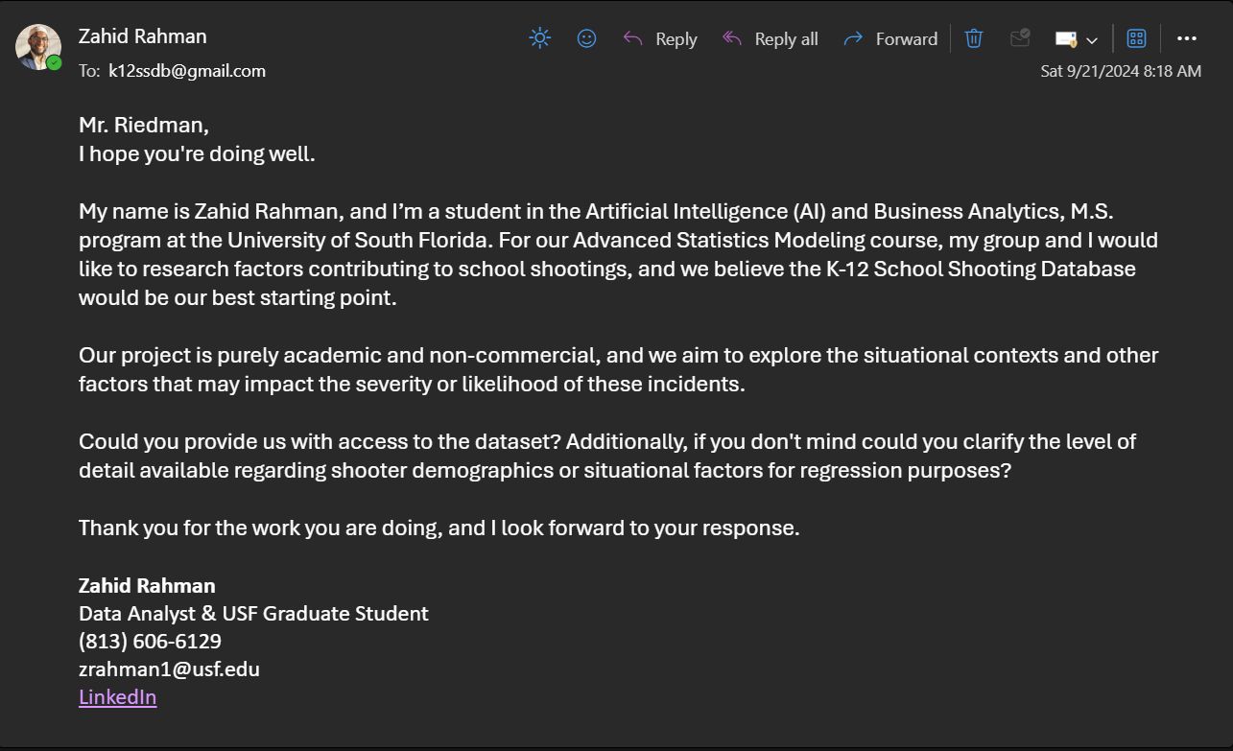

Obtaining the Data

Slide 16
We need a Data Dictionary
In raw form, the data is in an Excel Spreadsheet, containing almost 60 features across 4 different sheets, Incident, Shooter, Victim, and Weapon, for a total of 13,000 rows
Notable features include: Number_Victims, Shooter_Affiliation, Weapon_Type, Hostages, Gang_Related, Location
Need to build a data dictionary to better understand all the features and what needs to be done for data cleaning
Key Questions:
Is there missing data and how much?
What features should be kept and which should be dropped?

Slide 17

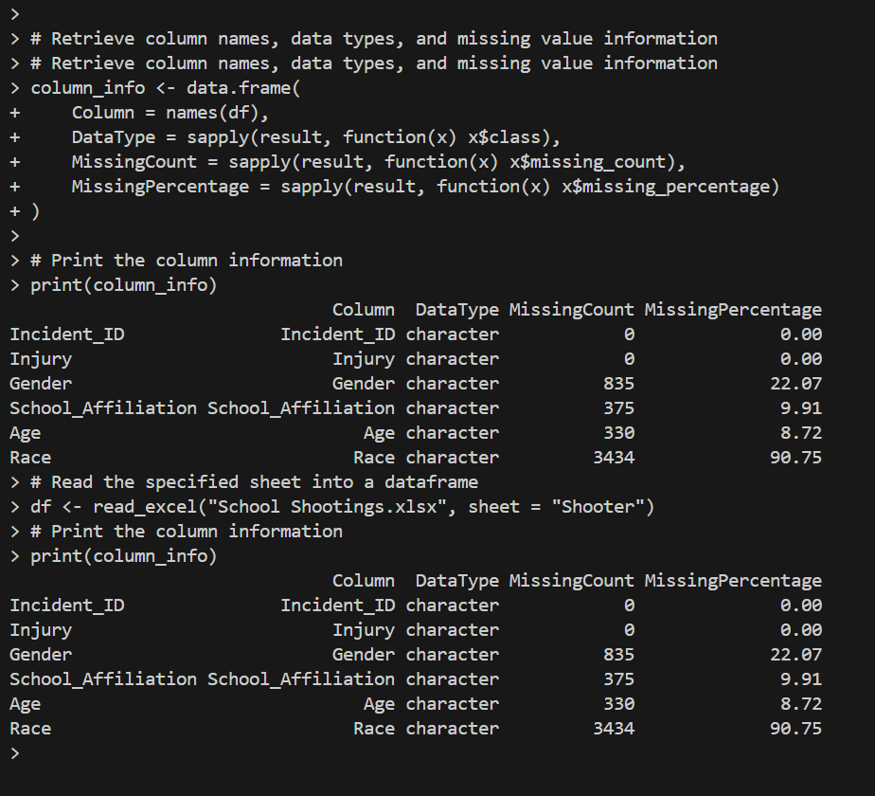
Using R to build Data Dictionary
I explored the original dataset and for each sheet, extracted column names, data types, and % of missing values

Slide 18
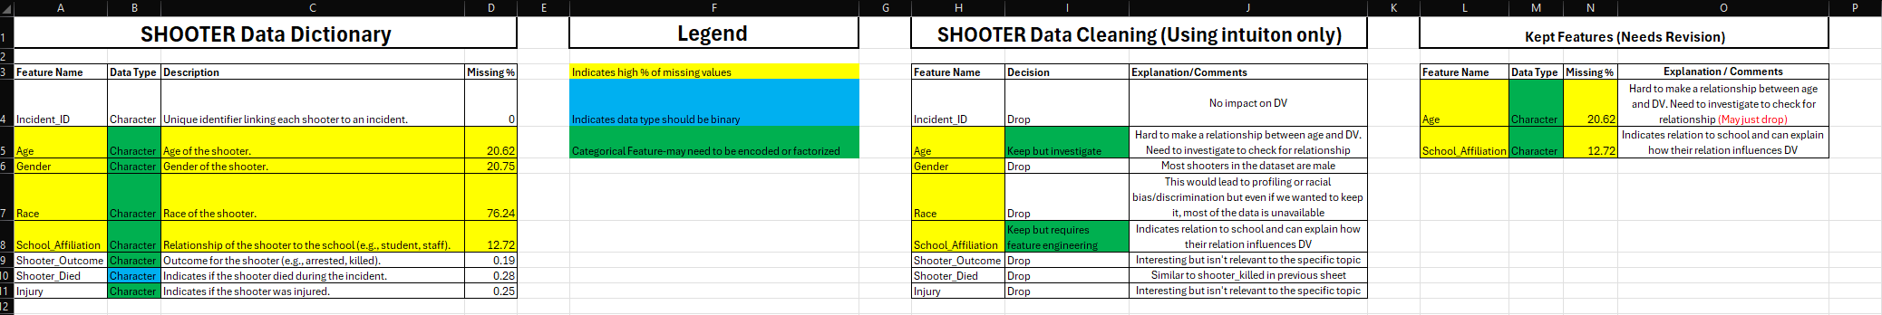
Using Data Dictionary for basic feature selection
Created a new Excel workbook and added the data dictionary.
Used limited domain knowledge to evaluate each feature for relevance to the dependent variable (DV).
Made decisions to keep or drop features, documenting the reasoning for each.
Color-coded the Excel sheets for better clarity.

Slide 19
Final Selected Features

Slide 20
4
Preprocessing & EDA

Slide 21
Preprocessing P1
Filtering Data:
Retains rows where number of victims > 0 and excludes incidents labeled as "Accidental.
Handling Missing Values:
Identifies columns with missing values (sapply and colSums) and applies appropriate imputations.
Data Cleaning:
Drops unnecessary columns like Month, Day, Year, etc.
Standardizes state names (e.g., converting "Florida" to "FL").
Groups states into "High", "Medium," and "Low" gun control categories.
Feature Engineering:
Bins incident durations into "Under 1 min" and "Over 1 min.”
Handles rows with inconsistent or ambiguous values (e.g., "Multiple" or inequalities in Shots_Fired).
Creates age categories for shooters (Minor vs. Adult).

Slide 22
Preprocessing P2
Merging Data:
Merges datasets (Incident, Shooter, etc.) on a common identifier (Incident_ID) to create a comprehensive dataset.
Data Validation:
Identifies and addresses duplicated or invalid values.
Drops rows with unresolvable inconsistencies (e.g., missing critical details like Location_Type).
Drop & Handle Categorical Features:
Handles categorical variables by consolidating levels (e.g., School_Level, Location_Type).
Drops features deemed irrelevant or overly sparse (e.g., Race, Weapon_Caliber).

Slide 23
EDA
High Occurrence During School Hours
Gang-Related Incidents:
Many incidents outside school buildings are tied to gang activity
Victim Counts:
High schools report more casualties compared to elementary or middle schools.
Longer incidents lead to higher victim numbers, highlighting the importance of rapid response.
Impact of Law Enforcement:
The presence of officers significantly reduces casualties, demonstrating their deterrent effect on incident severity.

Slide 24
5
Modeling, Results, Recommendation

Slide 25
Modelling P1
GLM with poisson
Model 1
Number of Victims
School Level
Location Type
Situation
Time Period
Gang Related
Weapon Type
Officer Involved
Shooter Killed
DV
Predictors
This model is designed to predict the number of victims in a school shooting based on a set of situational and contextual factors
GLM with Binomial
Model 2
During Classes
School Level
Time Period
Location Type
DV
Predictors
This model explores the likelihood of an incident occurring during class hours, which is crucial for understanding the risk to students during instructional time

Slide 26
Modelling P2
GLM with Binomial
Model 3
Gang Related
School Level
State Gun Control
School Affiliation
Location Type
Weapon Type
DV
Predictors
This model focuses on identifying factors associated with gang-related incidents
GLM with Binomial
Model 4
Number victims > 1
School Level
Situation
Time Period
Weapon Type
Location Type
Gang Related
Shots Fired
Age
DV
Predictors
This model aims to predict high-casualty incidents, defined as those with more than one victim, using logistic regression

Slide 27
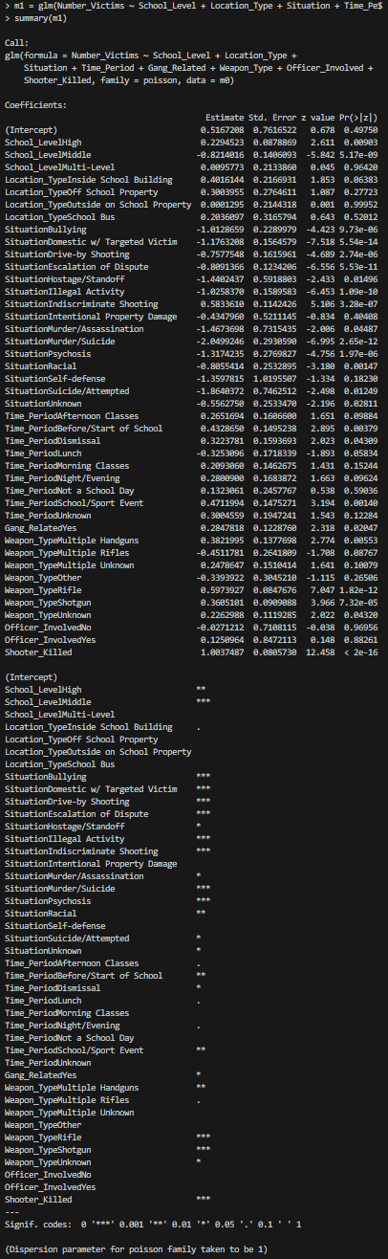
Result of Model 1
Model 1
High Schools: Incidents in high schools see about 2.5 times more victims than in elementary schools.
Inside School Buildings: Shootings inside buildings result in roughly 30% more victims than those outside.
Drive-by Shootings: Drive-by incidents increase victim counts by nearly 200%.
Time of Day: Incidents during lunch or school events see around 20-30% more victims than other times.
Weapon Type: Shotguns are associated with 40% more victims compared to handguns.
Gang-Related Incidents: Gang-involved shootings tend to have about 25% more victims.

Slide 28
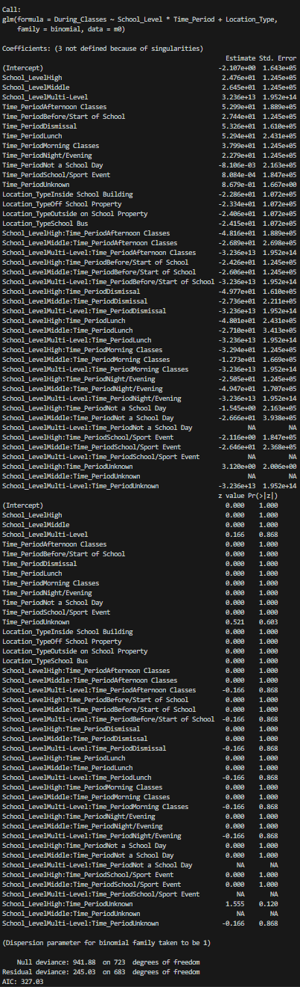
Result of Model 2
Model 2
High Schools: Incidents at high schools are 12 x more likely to occur during class hours than at elementary schools
Time Period - Morning Classes: Incidents are nearly 16 x more likely to happen during designated morning class hours than at other times
Location - Inside School Building: Incidents are about 2x as likely to happen inside school buildings during classes
Combination of High School and Afternoon Classes: In high schools, incidents during afternoon classes are 6 times more likely,

Slide 29
Result of Model 3
Model 3
School Level: High school shootings are 4x more likely to be gang-related compared to elementary schools.
School Affiliation: Gang Member affiliation sharply increases the likelihood of a gang-related incident. Similarly, affiliation as a Rival School Student significantly raises this probability. Conversely, affiliations like Police Officer/SRO or Teacher reduce the likelihood.
Location Type: Shootings off school property are far less likely to be gang-related, while those on school grounds are more prone to gang involvement.
Weapon Type: Use of rifles and other firearm types correlates with lower chances of gang involvement.
State Gun Control x School Level: In states with low gun control, high school shootings are slightly less likely to be gang-related.
Gang Related
School Level
State Gun Control
School Affiliation
Location Type
Weapon Type

Slide 30
Result of Model 4
Model 4
Drive-by Shootings Outside (+): Strongly linked to multiple victims, indicating that such situations on school peripheries are especially high-risk.
Indiscriminate Shootings Inside (+): High risk for multiple victims, underscoring the danger of random targeting in confined spaces like classrooms.
Weapon Type:
Rifles (+): Associated with more victims due to their higher lethality.
Multiple Firearms (+): Significantly increases the likelihood of multiple casualties.
High School Level (+1.41): High schools show a stronger correlation with incidents involving multiple victims compared to other levels.
Gang-Related Incidents (+): Higher probability of multiple victims, pointing to the group-targeting nature of gang violence.
Shots Fired (+): Each additional shot fired increases the likelihood of more casualties, emphasizing the impact of sustained gunfire.
Adult Shooters (+): Incidents involving adults are more likely to result in multiple victims than those involving minors.
Number victims > 1
School Level
Situation
Time Period
Weapon Type
Gang Related
Shots Fired
Location Type
Age

Slide 31
Recommendations P1
Increase High School Security During Classes
Reinforce Building Entry Points
Target Gang Prevention Programs in High Schools
Boost security presence and monitoring, especially during high-risk times like morning and afternoon classes, where incidents are more likely
Implement controlled access to reduce risks for incidents inside school buildings, where victim counts tend to be higher. Train staff and students on lockdown procedures.
Launch anti-gang initiatives and collaborate with local law enforcement in high schools to reduce gang-related incidents
Strengthen Perimeter for Drive-By Prevention
Install barriers around school perimeters to reduce drive-by shooting risks, especially in high-risk high schools

Slide 32
Recommendations P2
Heighten Security at Lunch and School Events
Early Intervention for At-Risk Students
Train Staff on Recognizing Warning Signs
Increase supervision and deploy security personnel during lunch hours and school events, which show higher victim counts
Implement programs focusing on mental health and conflict resolution to reduce violence risks, particularly among students with known gang affiliations
Educate teachers and staff on identifying signs of potential violence, enabling quicker intervention
Collaborate on Gun-Free School Zones
Work with local authorities to establish and enforce firearm-free zones around schools, especially high schools, to limit high-lethality firearms near campuses

Slide 33
6
Conclusion & References

Slide 34
Conclusion
School shootings remain a deeply complex and tragic issue, but our analysis sheds light on key factors that can help mitigate their impact. Incidents during class hours, gang-related activity outside school premises, and the length of an event all significantly influence victim counts. Notably, the presence of law enforcement consistently reduces casualties, highlighting the importance of proactive safety measures. We recommend enhancing school security during high-risk periods, investing in gang prevention programs, and training staff for rapid response to save lives when every second counts.
Looking Ahead
To build on this work, future studies should prioritize richer, more granular datasets, possibly through primary data collection, to uncover overlooked factors like mental health, community dynamics, or school safety policies. With greater funding, we could refine predictive models to identify schools most at risk and design targeted, evidence-based interventions.
Every incident is preventable. By acting on data-driven insights today, we can create safer schools tomorrow.

Slide 35
References
Collins, L. W., Landrum, T. J., & Sweigart, C. A. (2024). Getting ahead of school shootings: A call for action, advocacy and research. Preventing School Failure: Alternative Education for Children and Youth, 68(2), 167–173. https://doi.org/10.1080/1045988x.2024.2302144
Flannery, D. J., Fox, J. A., Wallace, L., Mulvey, E., & Modzeleski, W. (2021). Guns, school shooters, and School Safety: What we know and directions for change. School Psychology Review, 50(2–3), 237–253. https://doi.org/10.1080/2372966x.2020.1846458
Katsiyannis, A., Rapa, L. J., Whitford, D. K., & Scott, S. N. (2023). Correction to: An examination of US school mass shootings, 2017–2022: Findings and implications. Advances in Neurodevelopmental Disorders. https://doi.org/10.1007/s41252-023-00383-w
Reeping, P. M., Klarevas, L., Rajan, S., Rowhani-Rahbar, A., Heinze, J., Zeoli, A. M., Goyal, M. K., Zimmerman, M. A., & Branas, C. C. (2022). State firearm laws, gun ownership, and K-12 school shootings: Implications for School Safety. Journal of School Violence, 21(2), 132–146. https://doi.org/10.1080/15388220.2021.2018332
Riedman, D. (n.d.). Methodology for Collecting School Shooting Data. K-12 School Shooting Database. https://k12ssdb.org/methodology-1

Slide 36
References P2
Schildkraut, J., Connell, N., Barbieri, N., & de Azeredo, R. (2023). American uniqueness revisited: A Comparative Examination of two school shootings using the path to intended violence. International Journal of Comparative and Applied Criminal Justice, 48(2), 143–158. https://doi.org/10.1080/01924036.2023.2221751
Surviving a school shooting: Impacts on the mental health, education, and earnings of American Youth. Stanford Institute for Economic Policy Research (SIEPR). (n.d.). https://siepr.stanford.edu/publications/health/surviving-school-shooting-impacts-mental-health-education-and-earnings-american
USAFacts. (2024, February 20). The latest government data on school shootings. https://usafacts.org/articles/the-latest-government-data-on-school-shootings/
Winch, A. T., Alexander, K., Bowers, C., Straub, F., & Beidel, D. C. (2024). An evaluation of completed and averted school shootings. Frontiers in Public Health, 11. https://doi.org/10.3389/fpubh.2023.1305286

